Slide 1
Techmasters Entrance Exam
Please title your paper with name, date, and the title “Techmasters”

Slide 2
Question One

Slide 3
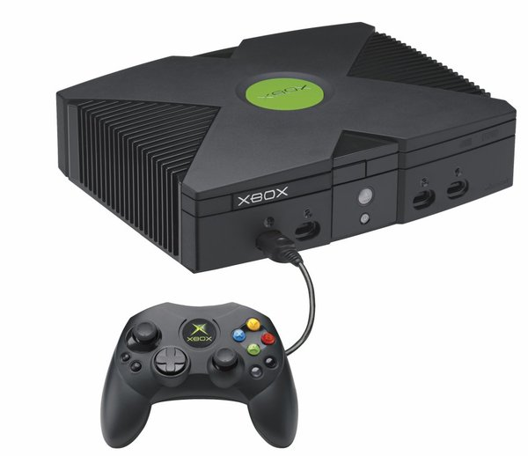


What is a computer?
An Xbox
A computer
Mayonnaise

Slide 4
Solution

Slide 5
This is a Techmasters Meeting
We will talk about stuff.

Slide 6
Our Meetings
First half is an introductory explanation of the topic (<time1> to <time2>)
Second half is a more complicated (and often more interesting) discussion (<time2> to<time3>)

Slide 7
Coming Meetings
We will begin the year with several tutorial meetings to get newcomers grounded in the basics of technology (tech veterans, have no fear--the second half of the meeting is entirely for you!)
We will have meetings on: hardware, software, programming, networking, Linux/shell/server, hacking, and many more

Slide 8
The Server
Linux server (Debian)
You all get server accounts
(even if you don’t want one)
So make good use of it
Also hosts website, and possibly some game servers

Slide 9
Weekly Problems
Something we are trying this year is sending out problems on all things tech
Consistent problem solvers may receive prizes at the end of term!
And now...

Slide 10
Last Weeks Problem
(which no one solved even though it was pretty simple (and Henry we heard you talking about GPG; you should be able to solve this!) (and it’s not like we talked about this EXACT topic last year… OH WAIT))
Above is a classic Lisp program
Also GPG

